Slide 1
Unit 4.3 Designing Interfaces and Dialogues
Introduction; Designing Interfaces and Dialogues (Process, Deliverables and Outcomes); Interaction Methods and Devices (Methods of Interacting, Hardware Options for System Interaction);
Designing Interfaces (Designing Layouts, Structuring Data Entry, Controlling Data Input, Providing Feedback, Providing Help); Designing Dialogues; Designing Interfaces and Dialogues in
Graphical Environments

Slide 2
Process of Designing interfaces and Dialogues
Similar to designing forms and reports, the process of designing interfaces and dialogues is a user-focused activity. This means that you follow a prototyping methodology of iteratively collecting information, constructing a prototype, assessing usability, and making refinements. To design usable interfaces and dialogues, you must answer the same who, what, when, where, and how questions used to guide the design of forms and reports.

Slide 3
Methods of interacting
Command Language Interaction : In command language interaction, the user enters explicit statements to invoke operations within a system. This type of interaction requires users to remember command syntax and semantics
Menu interaction : A human–computer interaction method in which a list of system options is provided and a specific command is invoked by user selection of a menu option.
Form interaction : A highly intuitive human–computer interaction method whereby data fields are formatted in a manner similar to paper based forms.

Slide 4
Methods of interacting
Object-based interaction : A human–computer interaction method in which symbols (Icon ) are used to represent commands or functions. Icon is a Graphical picture that represents specific functions within a system.
Natural language interaction : A human–computer interaction method whereby inputs to and outputs from a computer-based application are in a conventional spoken language such as English.

Slide 5
Pop-up menu
A menu-positioning method that places a menu near the current cursor position.
Drop-down menu
A menu-positioning method that places the access point of the menu near the top line of the display; when accessed, menus open by dropping down onto the display.

Slide 6
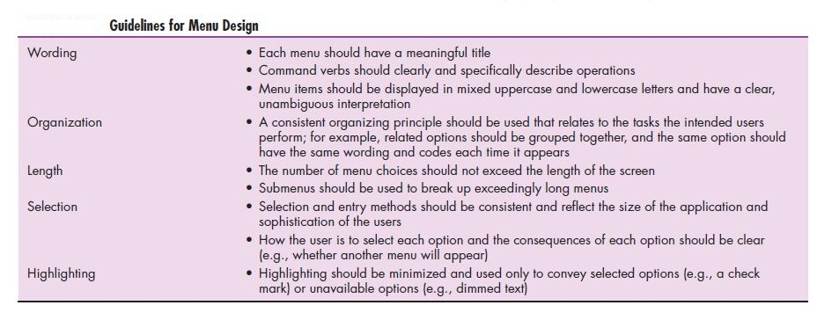

Slide 7
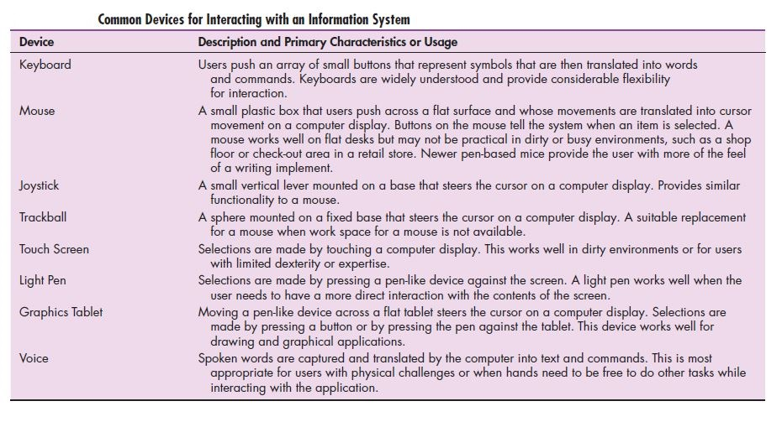
Hardware options for system interaction

Slide 8
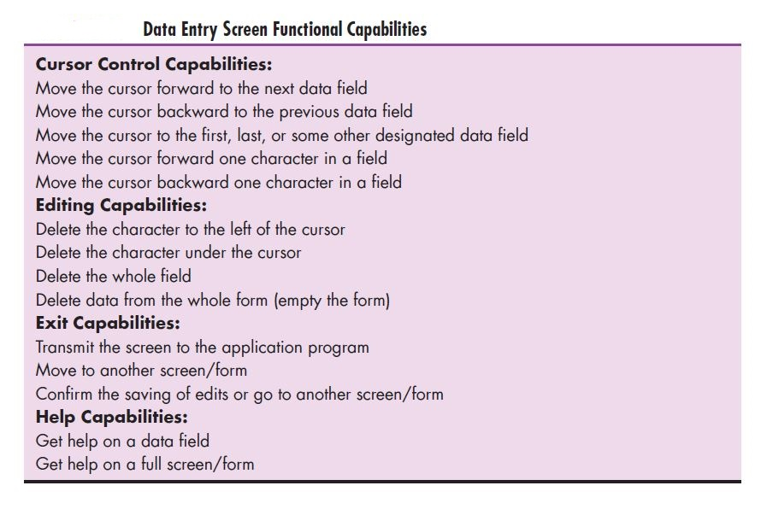

Slide 9
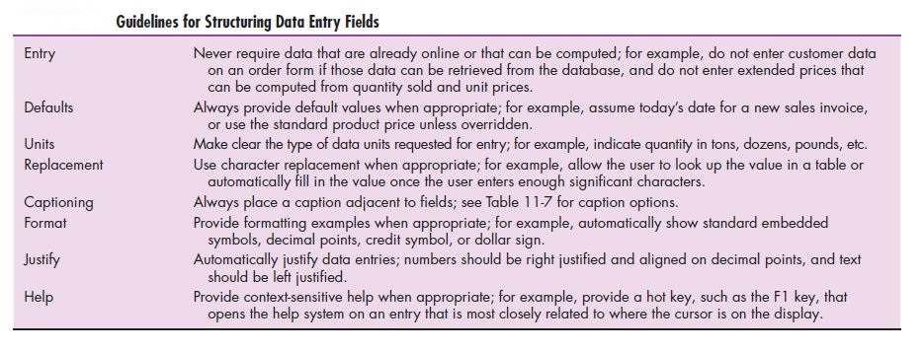

Slide 10
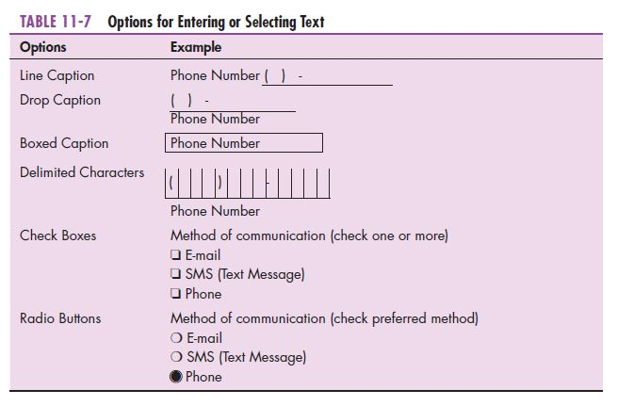

Slide 11
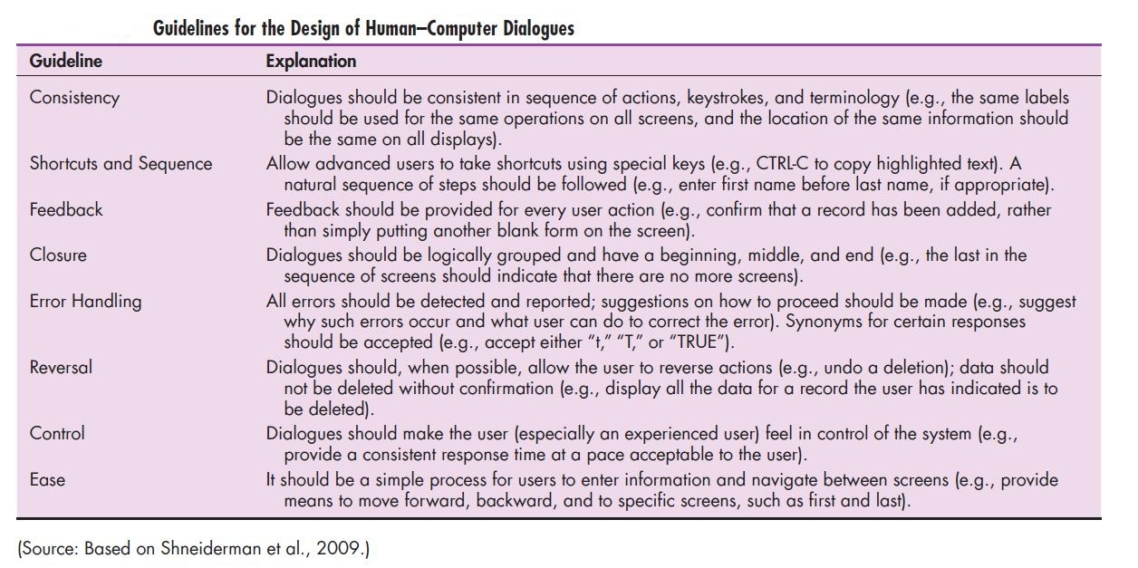
Dialogue : The sequence of interaction between a user and a system.

Slide 12
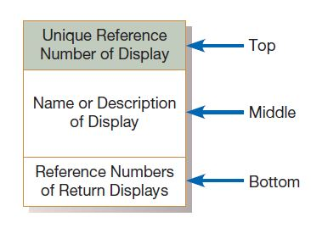
Dialogue diagramming
A formal method for designing and representing human–computer dialogues using box and line diagrams.
The three sections of the box are used as follows:
Top: Contains a unique display reference number used by other displays for referencing it.
Middle: Contains the name or description of the display.
Bottom: Contains display reference numbers that can be accessed from the current display.

Slide 13
